Slide 1
Review Session Week 2
Important Ideas:
Why are neural networks interesting in perception?
A link between Cognition and Neuroscience
I wish to thank MIT BMM Summer school for some of the slides of this
presentation

Slide 2
The big question
How does the mind get so much out of so little?
Josh Tenenbaum

Slide 3
https://www.youtube.com/watch?v=aircAruvnKk

Slide 4
Inferior temporal cortex
•
Hubel and Wiesel
•
https://www.youtube.com/watch?v=Cw5PKV9Rj3o
12

Slide 5
Outline
•
Neurons
•
Resting potential (ion concentrations/channels)
•
Action potential & PSPs
•
Basic brain anatomy
•
Inferior, superior, ventral, dorsal
•
Occipital, temporal, parietal, frontral lobes
•
Grey/white matter
•
Neural recordings - EPhys, EEG/MEG, fMRI
•
Visual system
•
Hierarchy: V1—> IT
•
Receptive ﬁelds
•
Computational models
3

Slide 6

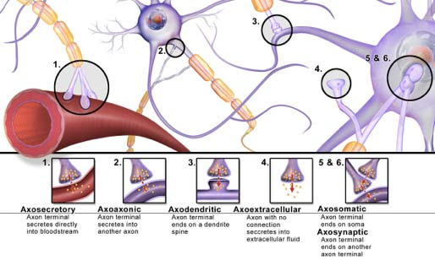
Neurons
•
Soma (cell body), dendrites, axons
•
Synapses
This image is in the public domain.
4

Slide 7
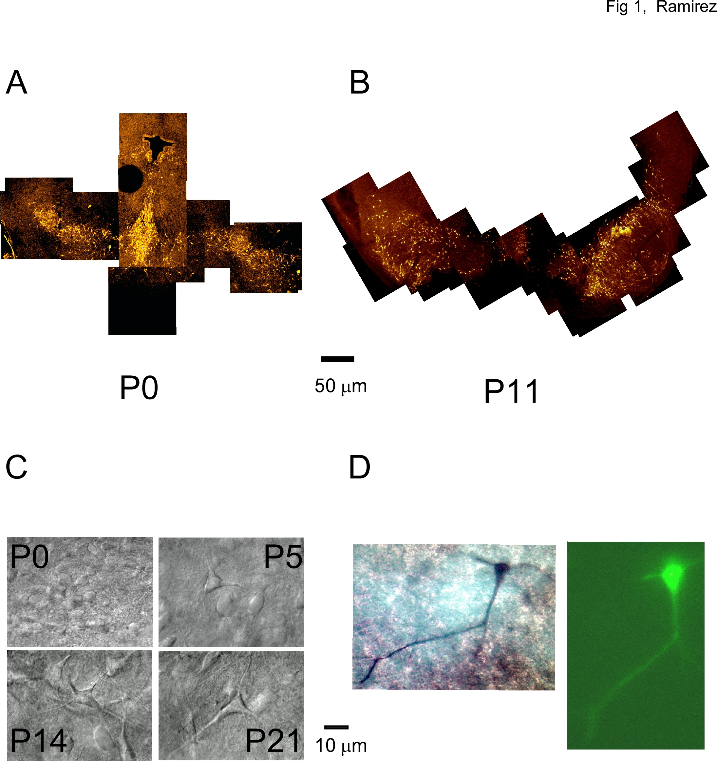

Slide 8
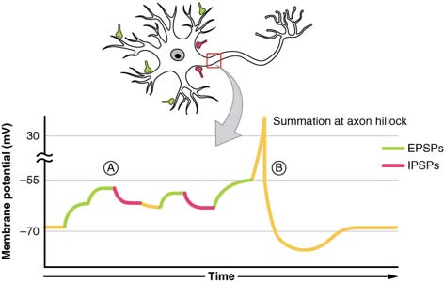
Neuron
•
Ion channels and resting membrane potential
•
Post-synaptic potential
•
Action potentials
•
“Spiking”/ﬁring
Courtesy of OpenStax. License CC BY.
5

Slide 9
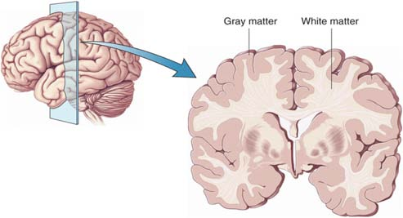
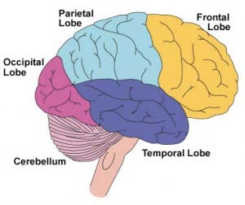
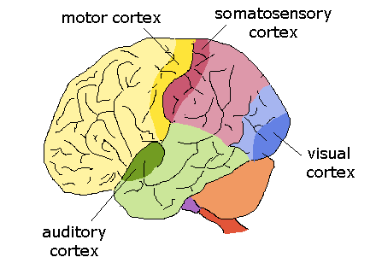
Basic brain anatomy
Superior
Anterior
Posterior
Inferior
© Source Unknown. All rights reserved. This content is
excluded from our Creative Commons license. For more
information, see https://ocw.mit.edu/help/faq-fair-use/.
6

Slide 10
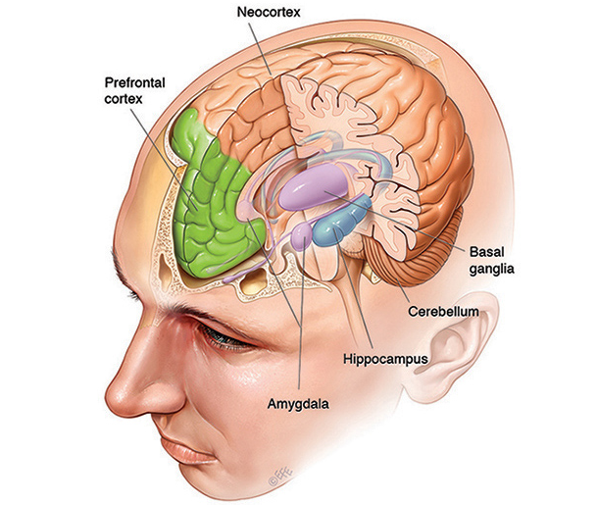

Slide 11
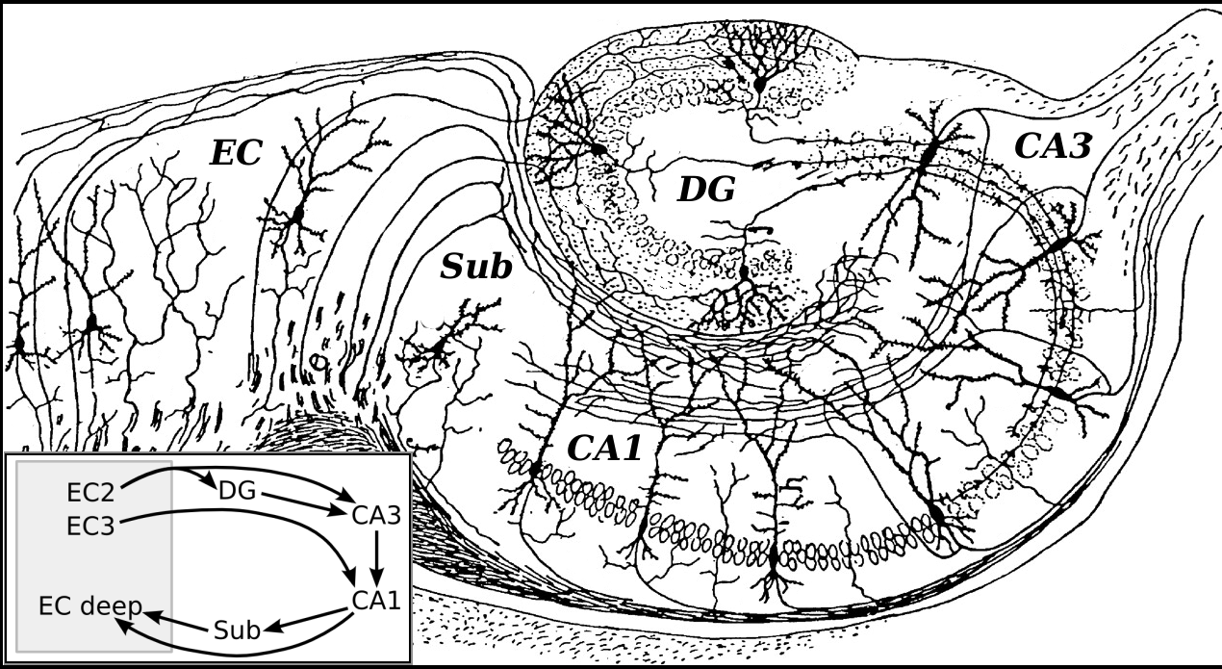

Slide 12
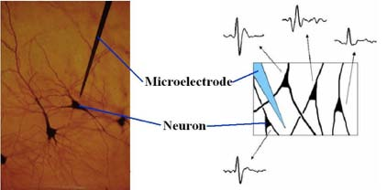
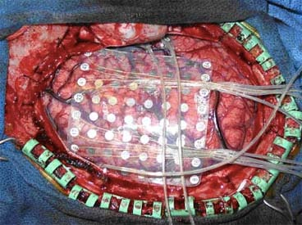
Invasive neural recordings
•
Electrophysiology
•
Single unit (intra or extracellularly)
•
Multi-unit/local ﬁeld potentials
•
Electrocorticography (ECoG)
7

Slide 13
Comparing neural recordings
•
Electrophysiology recordings - high spatiotemporal
resolution, limited brain coverage
•
fMRI - high spatial resolution data, broad coverage, low
temporal resolution
•
EEG/MEG - high temporal resolution, broad coverage,
low spatial information
9

Slide 14
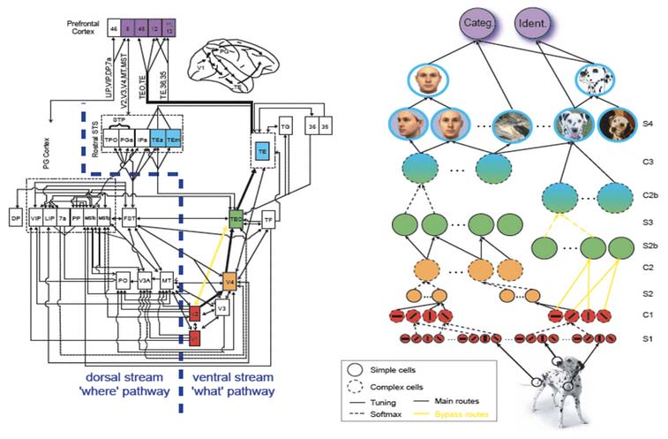
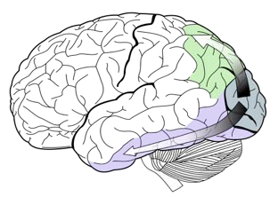
Visual processing in the human brain
•
Ventral Stream - “What” Pathway
•
Dorsal Stream - “Where” Pathway
Dorsal
stream
V1
Ventral stream
Dorsal
Ventral
stream
stream
10

Slide 15
Ventral visual processing stream
•
Many layers organized in a hierarchy
•
First layer: primary visual cortex (V1) - cells respond to
oriented lines and edges
•
Top layer: inferior temporal cortex (IT) - cells respond to
entire objects and are both selective and invariant
Dorsal
stream
V1
Ventral stream
11

Slide 16
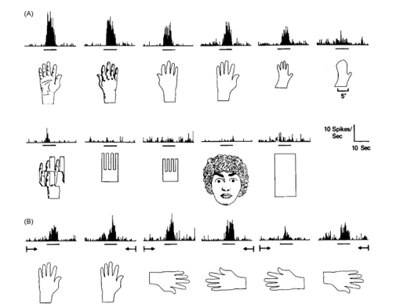
Inferior temporal cortex
Single neuron studies of inferior temporal cortex
Gross
13

Slide 17
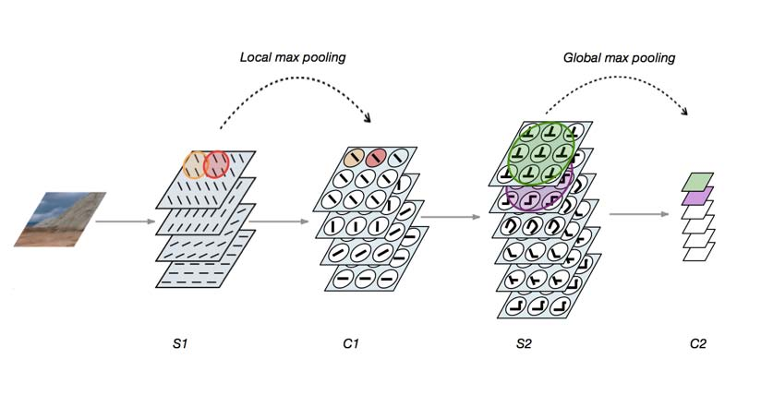
Hierarchical feedforward models
•
Inspired by Hubel and Wiesel’s ﬁndings in visual cortex
•
Simple cells - template matching, build selectivity
•
Complex cells - pooling, build invariance
15

Slide 18
Review Session Week 2
Important Ideas:
Why are neural networks interesting in perception?
A link between Cognition and Neuroscience

